Slide 1
Causal Discovery in Manufacturing: A Structured Literature Review
Speaker: Ting-Yun Ou
Teacher: Wen-Chih Peng
https://www.mdpi.com/2504-4494/6/1/10

Slide 2
RCA in Industrial data

Slide 3
Outline
Dataset & Method
Conclusion

Slide 4
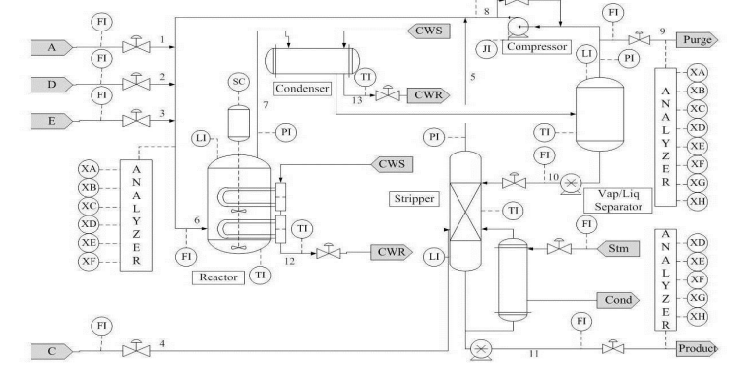
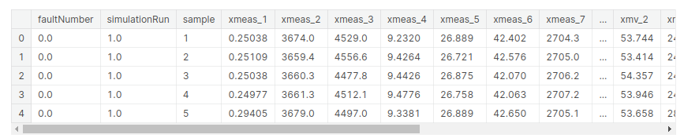
Tennessee Eastman Process(化學廠) Download Dataset
Industrial chemical process
Variables: 11 (manipulated) + 41 (measured)
time
41
Released Dataset

Slide 5



Tennessee Eastman Process(化學廠) Download Dataset
Anomaly detection scenario:
Lstm - X: (99490, 10, 52) Y: (99490, 52)
RCA scenario:
Root Cause Diagnosis of Process Faults Using Conditional Granger Causality Analysis and Maximum Spanning Tree [IEEE’ 18]
Input :
Output: Root Cause V_{j,} where j is the variable index
，
…… X₅₂
Released Dataset
[32] [33] [34] [69] [70] [71]

Slide 6
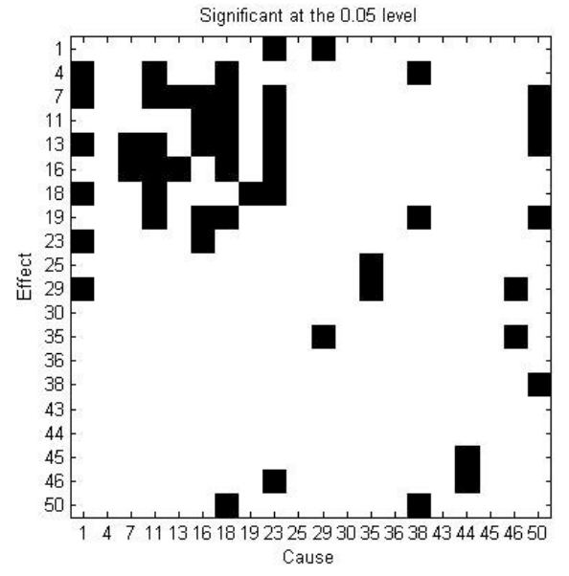
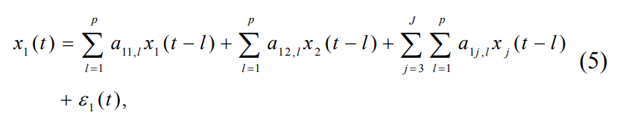
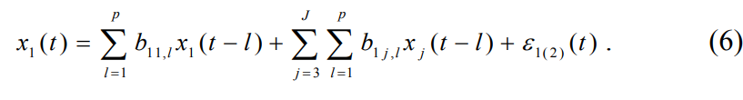
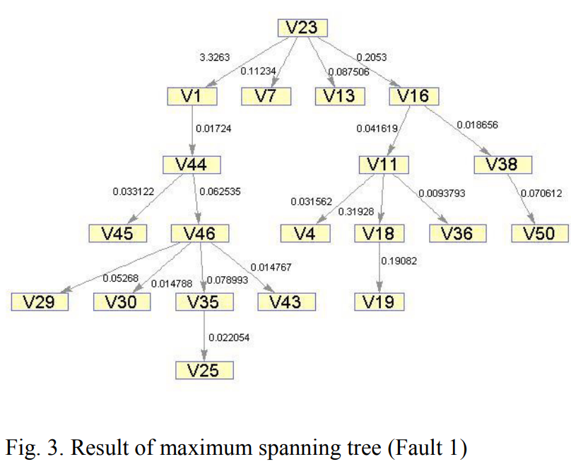
Tennessee Eastman Process(化學廠) Download Dataset
RCA scenario:
multivariate GC technique
maximum spanning tree
remove X₂

Slide 7
Tennessee Eastman Process(化學廠) Download Dataset
Root Cause Diagnosis of Oscillation-Type Plant Faults Using Nonlinear Causality Analysis [ELSEVIER’ 17]
two-step diagnosis approach to find nonlinear causal relationship + Lasso-based reconstruction analysis method
Probability Density Estimation and Bayesian Causal Analysis Based Fault Detection and Root Identification [ACS’ 18]
kernel density estimation (base on BN) to get causal structure
Transfer Zero-Entropy and Its Application for Capturing Cause and Effect Relationship Between Variables [IEEE’ 13]
Direct transfer 0-entropy (DT0E)
Released Dataset
[32] [33] [34] [69] [70] [71]

Slide 8
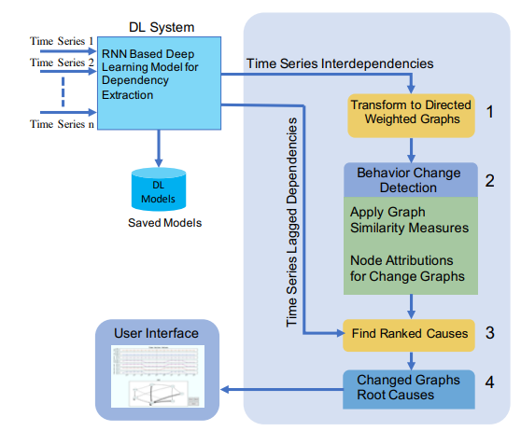
Commercial semiconductor manufacturing plant
Root Cause Detection using Dynamic Dependency Graphs from Time Series Data [IEEE' 18]
7 time series: recipe, step, pressure, current, power, powersp, voltage
Method:
DL system and converts them into weighted directed graphs [Dependency analysis’ 17]
Dependencies extracted by causality techniques [Granger Causality’ 07] [graphical Granger method’ 07]
Dependencies convert to directed weighted graphs [DeltaCon’ 16]
Produce ranked cause [DeltaCon’ 16]
Non-released Dataset
[66]

Slide 9
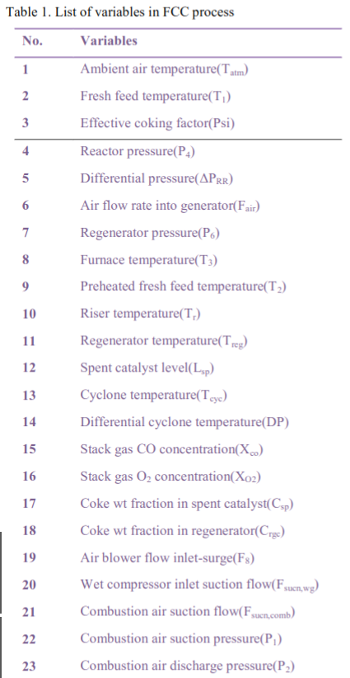
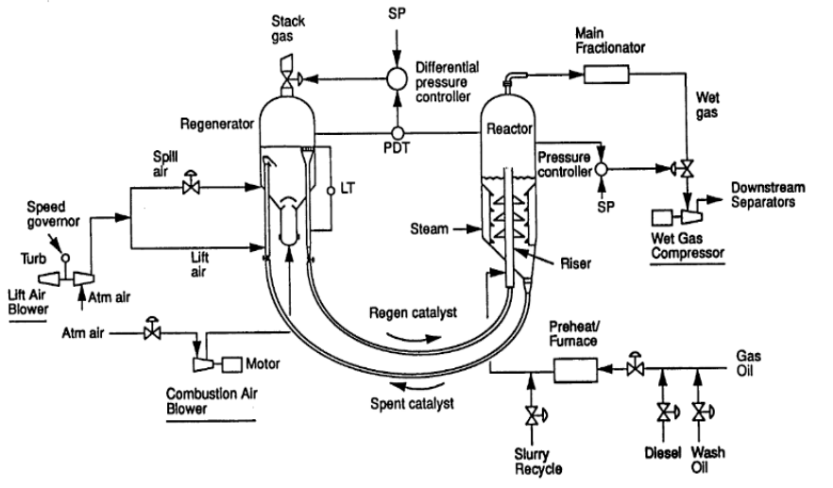
Fluid Catalytic Cracking unit (流化催化裂化裝置)
Causality analysis for root cause diagnosis in Fluid Catalytic Cracking unit [ELSEVIER’ 15]
PCA in combination with causality analysis based on network construction
Total 23 variables
Non-released Dataset
[64]

Slide 10
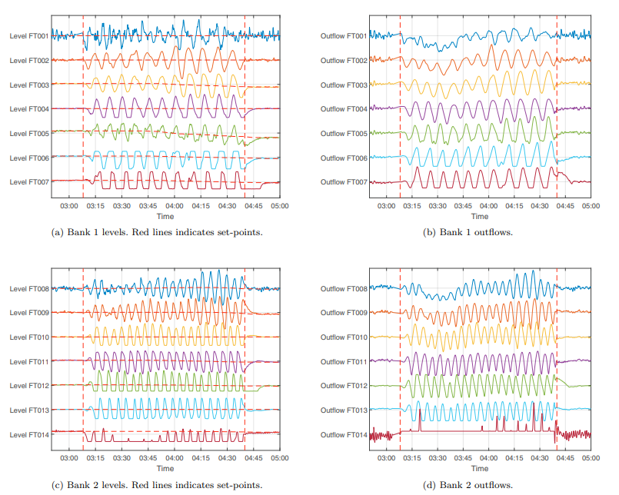
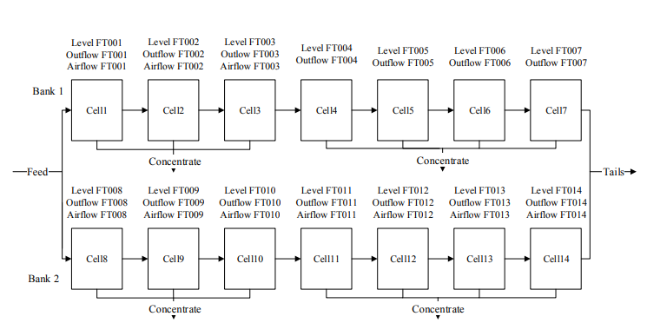
Mineral concentrator plants (礦廠)
Diagnosis of Oscillations in an Industrial Mineral Process Using Transfer Entropy and Nonlinearity Index [ELSEVIER’ 18]
Transfer entropy(causality analysis technique) + nonlinearity index
Total 28 variables
Non-released Dataset
[65]

Slide 11
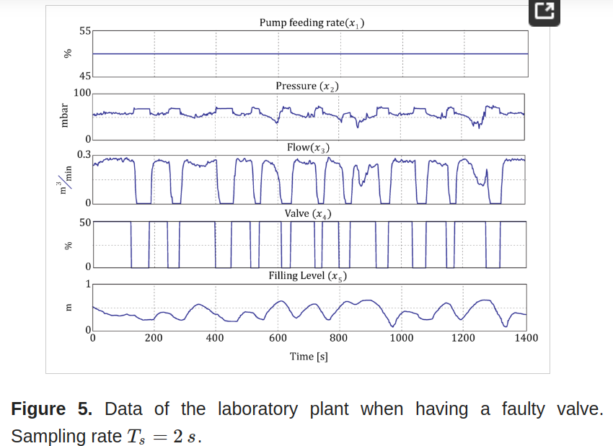
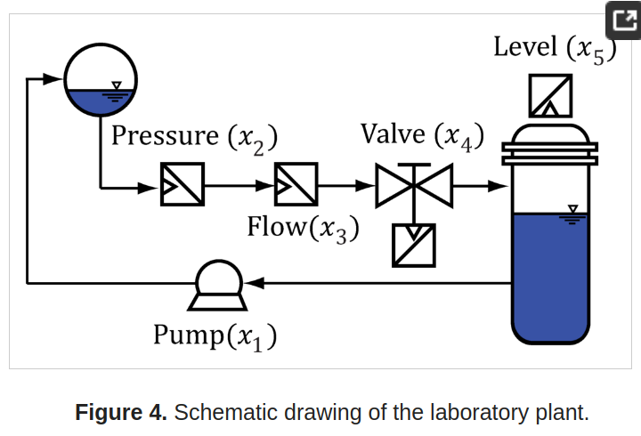
Chemical Stirred-tank Reactor (化學攪拌釜反應器)
Data-Driven Methods for the Detection of Causal Structures in Process Technology [MDPI' 14]
Methods for Reconstructing the Disturbance Propagation Path
Cross-Correlation Function
Granger Causality
Transfer Entropy
Support Vector Machines for Regression
Reconstruction of the Disturbance Propagation Path and Localization of the Root Cause
Non-released Dataset
[67]

Slide 12
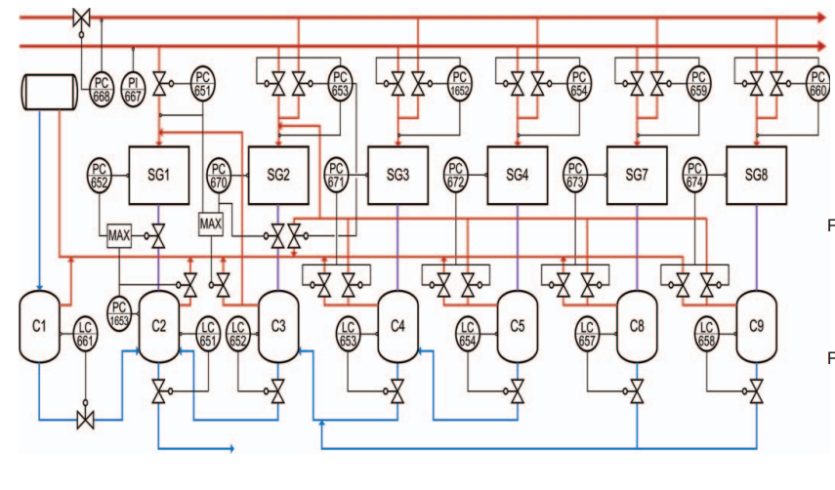
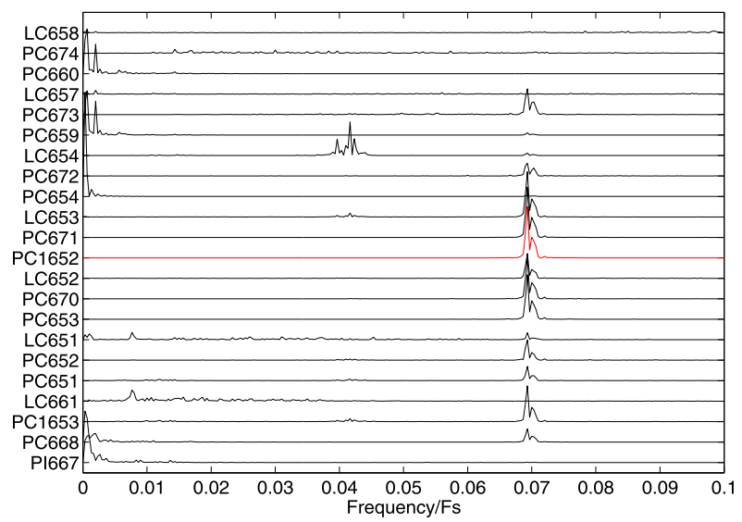
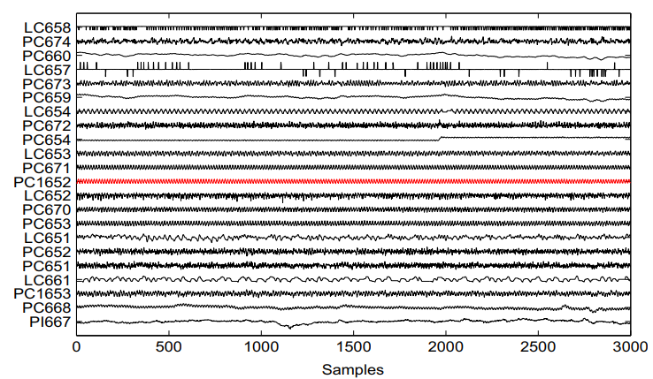
Industrial board machine (工業造紙機)
Red pipelines denote steam(蒸氣)
Blue pipelines denote condensate (冷凝物)
Purple pipelines denote a mixture of condensate and steam
22 measured process variables and spectra of the process variables
Non-released Dataset
[59] [60] [61] [62] [63]

Slide 13
Industrial board machine (工業造紙機)
Hybrid causal analysis combining a nonparametric multiplicative regression causality estimator with process connectivity information [ELSEVIER’ 19]
nonlinear causal analysis based on nonparametric multiplicative regression (NPMR) for identifying the propagation of an oscillatory disturbance via control loops
Fault propagation analysis of oscillations in control loops using data-driven causality and plant connectivity [ELSEVIER’ 14]
integrating process causality and topology to determine the propagation path.
utilize process knowledge for isolating the most probable root cause
A new approach for implementing transfer entropy using process topology [IEEE’ 16]
Transfer entropy + information on process topology
Fault propagation analysis by combining data-driven causal analysis and plant connectivity [IEEE’ 14]
process causality and topology
search algorithm
Non-released Dataset
[59] [60] [61] [62] [63]

Slide 14
Outline
Dataset & Method
Conclusion

Slide 15
Conclusion
Dataset
Tennessee Eastman Process(化學廠) Download Dataset
Commercial semiconductor manufacturing plant (半導體)
Fluid Catalytic Cracking unit (流化催化裂化裝置)
Mineral concentrator plants (礦廠)
Chemical Stirred-tank Reactor (化學攪拌釜反應器)
Industrial board machine (工業造紙機)
Conclusion
The papers mentioned are old
Next
Find recently work
Understand the usage method

Slide 16
END

